Slide 1
Generating Supplementary Travel Guides from Social Media
Liu Yang^{1,2}, Jing Jiang², Lifu Huang^{1,2}, Minghui Qiu², Lizi Liao^{2,3}
¹Peking University
²Singapore Management University
³Beijing Institute of Technology

Slide 2
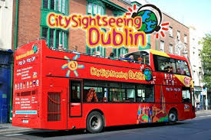

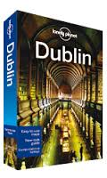
Dublin Sightseeing
Best places to eat
Chapter One: Michelin-starred Chapter One is our choice for city’s best eatery because…
Coppinger Row: Virtually all of the Mediterranean basin is represented…
Top things to do
Trinity College: On a summer’s evening, when the bustling crowds have gone for the day,…
St Patrick’s Cathedral: It was at this cathedral, reputedly, that St. Paddy himself…
Transport
Airlink Express Coach:…
Travel Guide Books
Are written by a few experts
Need to be constantly updated

Slide 3

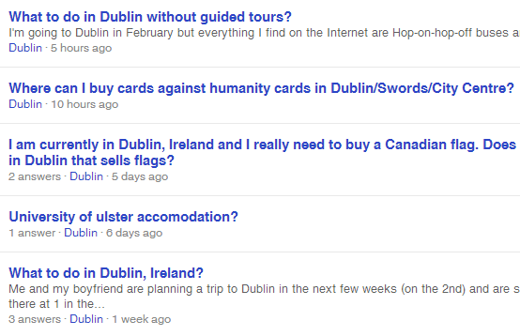

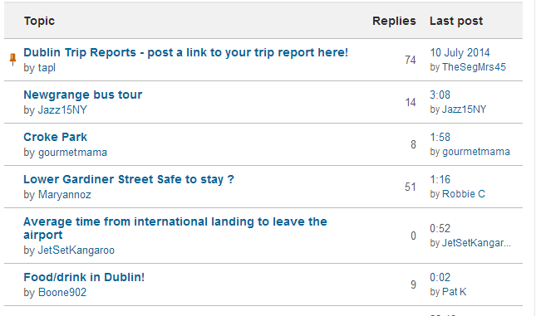


User-Generated Content

Slide 4
User-Generated Content
Is written by many ordinary online users
Wider coverage
Better represent popular attractions
Constantly grows
Fresh, up-to-date information
Objective of this work: To generate travel guides from online forums to supplement official travel guide books.
We formulate this task as a multi-document text summarization problem.

Slide 5
Challenges We Face
Forum threads and question/answer pairs are not well organized by topics or sections
Some threads and questions are too specific to be useful for a typical tourist
Coverage of points of interest is important but not considered in standard text summarization algorithms.

Slide 6
Roadmap
Motivation
Our Method
Method Overview
Joint City Section Model
Section Specific Summarization
Experiments
Conclusions

Slide 7
Method Overview
Thread selection
Use a latent variable model that jointly models official travel guides and forum threads
Allow the latent factors to adapt to the lexical variations in user-generated content
Align forum threads with the sections
Select the most relevant threads for each section
Section-specific summarization
Use an ILP-based extractive summarization framework
Give preference to more relevant sentences
Maximize the coverage of section-specific named entities

Slide 8
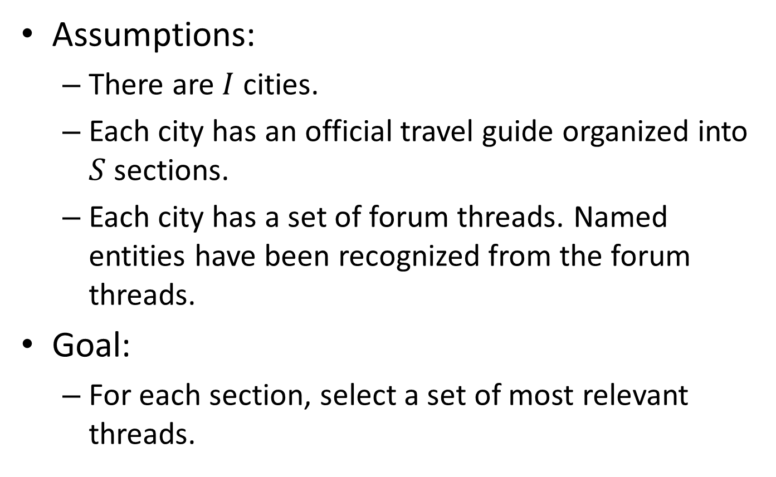
Thread Selection
Assumptions:
There are $I$ cities.
Each city has an official travel guide organized into $S$ sections.
Each city has a set of forum threads. Named entities have been recognized from the forum threads.
Goal:
For each section, select a set of most relevant threads.

Slide 9
Joint City Section Model
Each section is a latent topic with a word distribution
In official travel guides, section labels are known (supervision)
In forum posts, section labels are to be learned
Each city has a city-specific word distribution
E.g. “NYC” and “Manhattan” for New York City
In forum threads, we identify named entities and associate a section label with each named entity
Useful later for maximizing coverage of potential points of interest

Slide 10









Joint City Section Model
word distribution for each section
word distribution for each city
section distribution for each thread
section label for a named entity
c
$$θ_{j}$$
$$ψ_{s}$$
d
$$φ_{i}$$
L
$$x$$
w
z
$$y$$
section label for a word
$$M$$
N
K
$$J$$
switch variables to determine whether a word is section-related or city-related
I
I
$$S$$
$$π$$

Slide 11
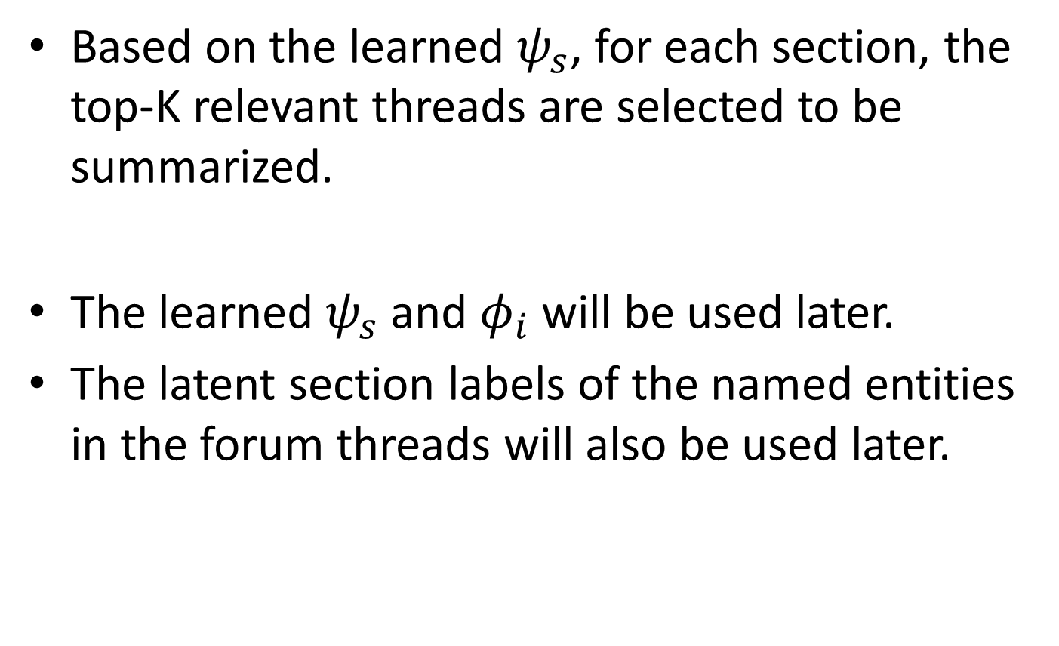
Thread Selection
Based on the learned $ψ_{s}$, for each section, the top-K relevant threads are selected to be summarized.
The learned $ψ_{s}$ and $φ_{i}$ will be used later.
The latent section labels of the named entities in the forum threads will also be used later.

Slide 12
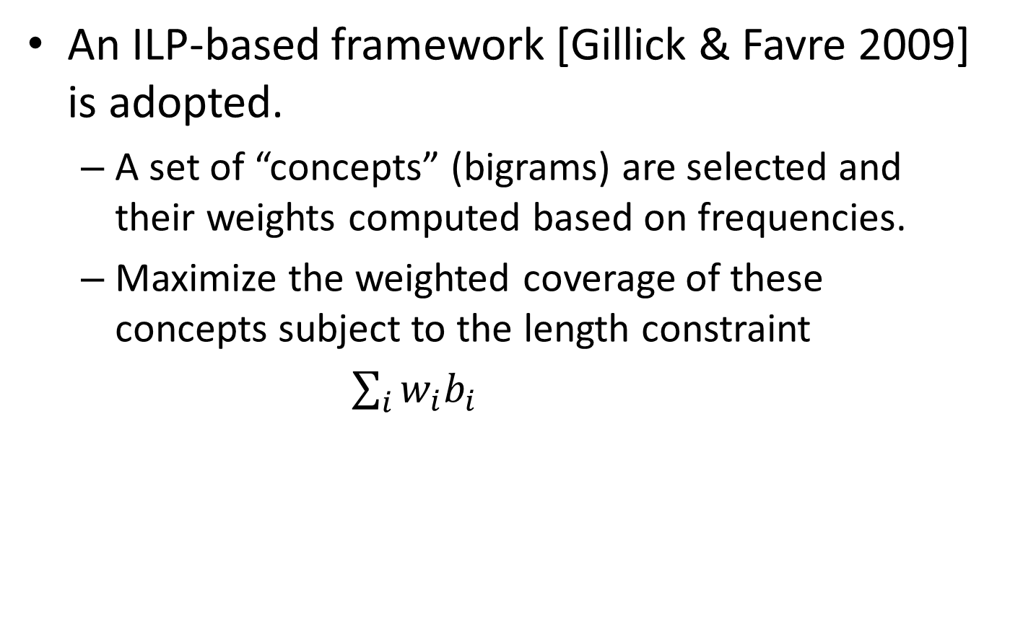
Section-specific Summarization
An ILP-based framework [Gillick & Favre 2009] is adopted.
A set of “concepts” (bigrams) are selected and their weights computed based on frequencies.
Maximize the weighted coverage of these concepts subject to the length constraint
$\sum_{i}{w_{i}b_{i}}$
weight for concept i
presence or absence of concept i

Slide 13
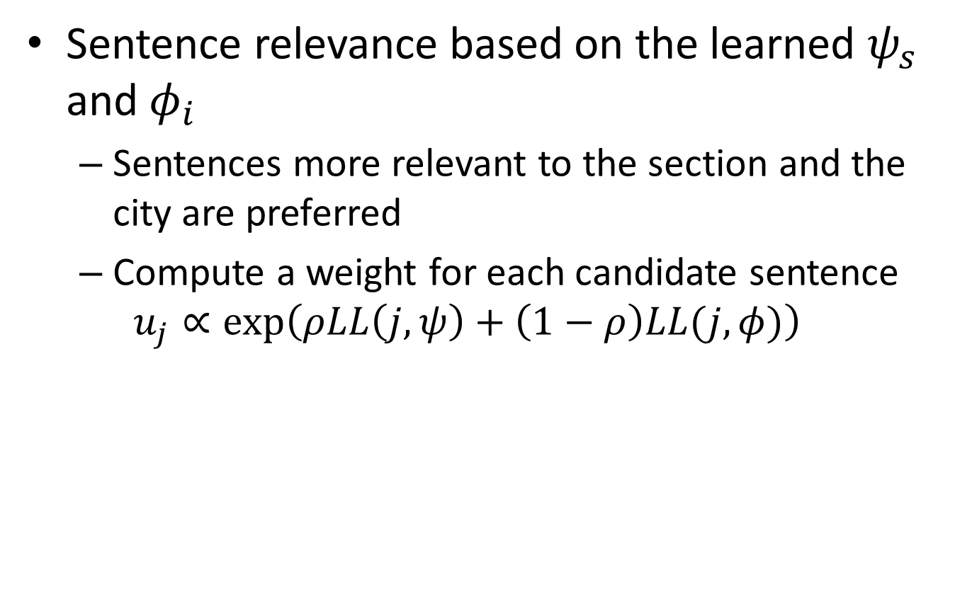
Our Modifications to the Objective Function
Sentence relevance based on the learned $ψ_{s}$ and $φ_{i}$
Sentences more relevant to the section and the city are preferred
Compute a weight for each candidate sentence
$$u_{j}∝exp⁡\left(ρLL\left(j,ψ\right)+\left(1−ρ\right)LL(j,φ)\right)$$
section-specific log likelihood
city-specific log likelihood

Slide 14
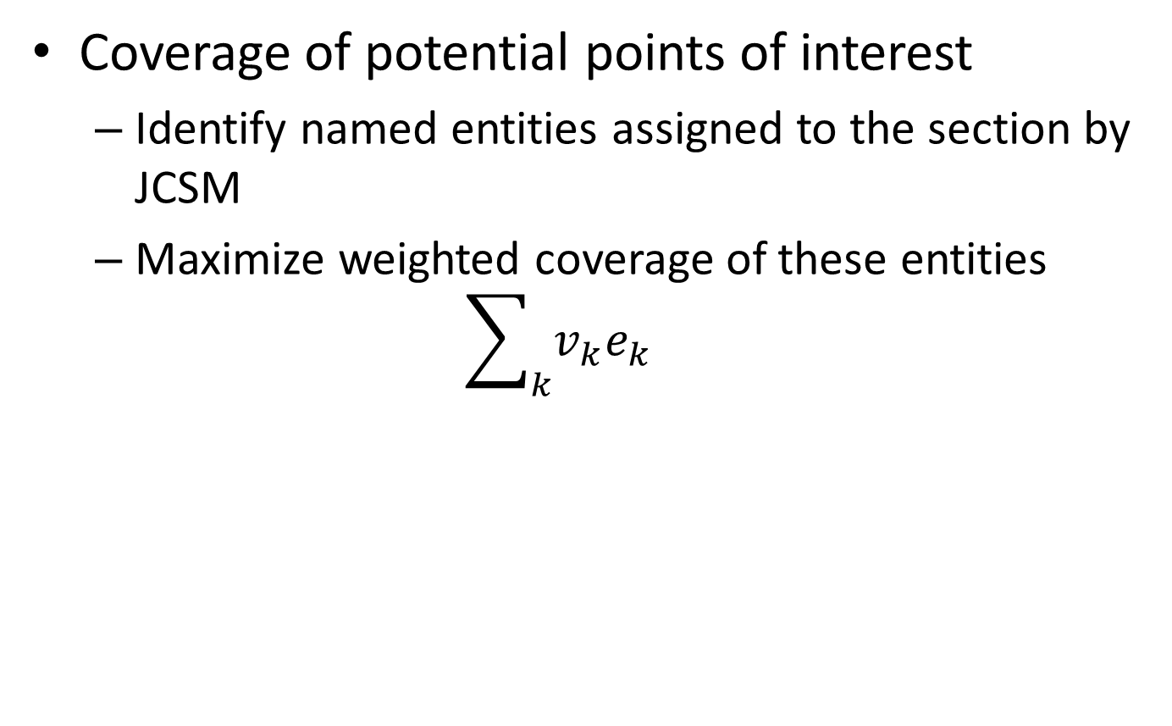
Our Modifications to the Objective Function
Coverage of potential points of interest
Identify named entities assigned to the section by JCSM
Maximize weighted coverage of these entities
$$\sum_{k}{v_{k}e_{k}}$$
weight for entity k belonging to this section
presence or absence of entity k

Slide 15
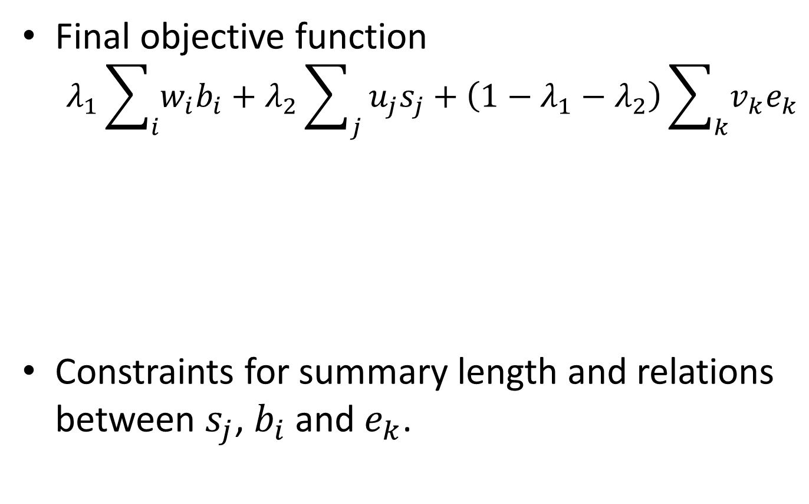
Our Modifications to the Objective Function
Final objective function
$$λ_{1}\sum_{i}{w_{i}b_{i}}+λ_{2}\sum_{j}{u_{j}s_{j}}+\left(1−λ_{1}−λ_{2}\right)\sum_{k}{v_{k}e_{k}}$$
Constraints for summary length and relations between $s_{j}$, $b_{i}$ and $e_{k}$.
concept coverage from original framework
sentence relevance
named entity coverage

Slide 16
Roadmap
Motivation
Our Method
Method Overview
Joint City Section Model
Section Specific Summarization
Experiments
Conclusions

Slide 17
Data
JCSM training
Ten official travel guides from Lonely Planet
Six hundred threads for each city from Yahoo! Answers
Section-specific summarization
Top-30 threads per section per city for summarization
Randomly picked 4 cities to obtain manually constructed summaries by human annotators

Slide 18
Baselines
Random
Centroid (Radev et al., 2004)
LexRank (Erkan and Radev, 2004)
DivRank (Mei et al., 2010)
GMDS (Wan, 2008)
ILP-BL (Gillick and Favre, 2009)

Slide 19
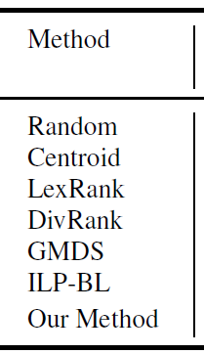
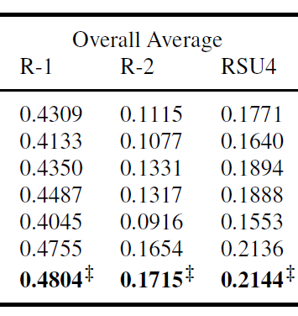
Overall Results
ROUGE scores
statistically significantly better than all baselines EXCEPT ILP-BL

Slide 20
Recall of Named Entities
Identify the named entities in the model summaries
Measure the recall of these named entities in the generated summaries
 | Singapore | Sydney | New York City | Los Angeles
ILP-BL | 0.3217 | 0.3539 | 0.3052 | 0.1860
Our method | 0.4606 | 0.5439 | 0.4766 | 0.3536

Slide 21
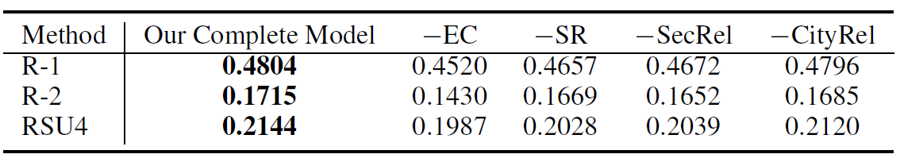
Different Components of the Objective Function
Compare the performance of different configurations of the summarization method
−EC: remove entity coverage
−SR: remove sentence relevance
−SecRel: remove only section-specific relevance
−CityRel: remove only city-specific relevance
All components are useful
City-specific sentence relevance is the least useful

Slide 22
Sample Summary Sentences for Sydney
It 's not too far from Sydney. Sydney is the most expensive place in Australia. They are a little lame ... Then you can go to Darling Harbour, a beautiful habour which is a 10-minute walk from town hall station…There are lots of interesting things to see and do in and around Sydney. The suburbs-much cheaper than the CBD... (by ILP-BL)
Restaurant | Go to the two major restaurant areas close to the city Darlinghurst, along Oxford Street , and Newtown, along King Street. Chinatown which is off George St. in the city look up Dixon st. is a great place to get a cheap Chinese meal…
Transport | The CBD is about 15 minutes by train from the airport and there is a station at Circular Quay, right on the Harbour with access to the bridge and the Opera House. You can catch an intercity train with Cityrail from just about anywhere in Sydney…
Entertainment | George Street has a number of bars . All the bars around the harbour are really good day and night . If you want to stay in a hotel where there is entertainment at night , you could look at Woolloomooloo, Darlinghurst , Surry Hills, Kings Cross or Potts Point… (by our method)

Slide 23
Roadmap
Motivation
Our Method
Method Overview
Joint City Section Model
Section Specific Summarization
Experiments
Conclusions

Slide 24
Conclusions
Proposed a summarization framework to generate well structured supplementary travel guides from social media
Used latent variable models and Integer Linear Programming
Align forum threads to section structure from official travel guides
Considers coverage of named entities when selecting summary sentences
Evaluated with real data from Yahoo! Answers and showed the effectiveness of our method

Slide 25
Thank You!
Q&A

